Slide 1

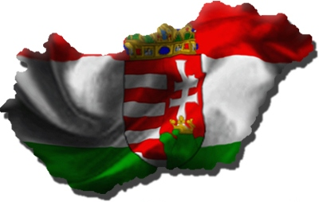

Slide 2
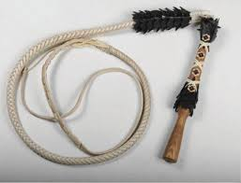
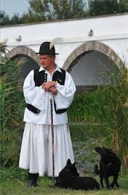
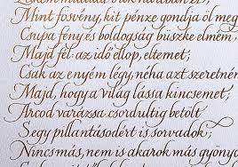
I don’t have a bullwhip
I speak a beautiful and hard language and my family name comes before my first name.
I don’t wear baggy pants
Hofsang Gergo

Slide 3
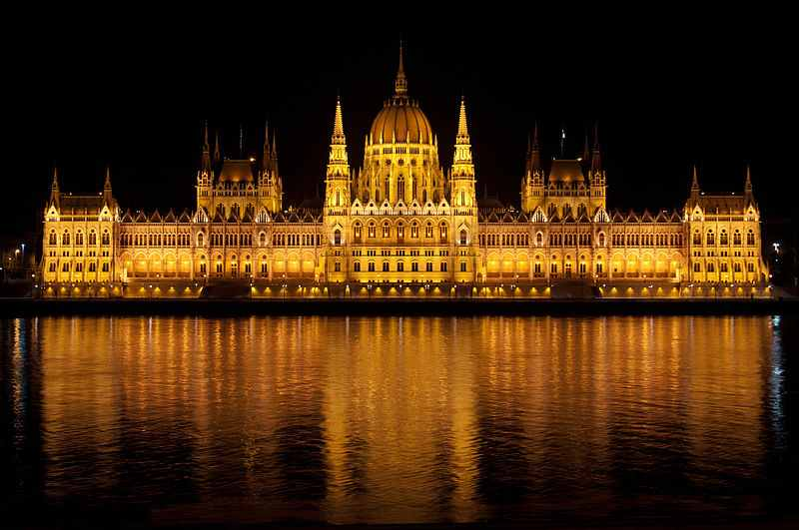
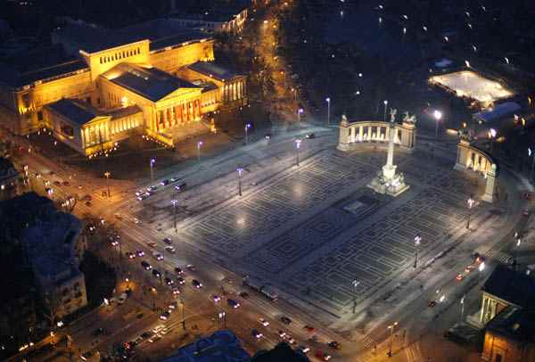
Hungary
Location: Central – Eastern Europe
Population: about 10 million
It is 93,036 km²
Capital city: Budapest
1,85 million people
Many famous buildings
and spas.

Slide 4
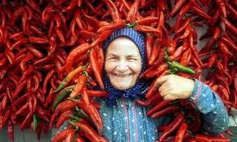

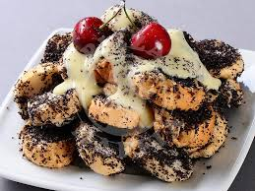
Our dishes are often spicy, due to the common use of hot paprika …
… or Erős Pista(Strong Steve), a very hot paprika cream ...
… or very sweet, like the „mákos guba”
(poppy seed dough)

Slide 5
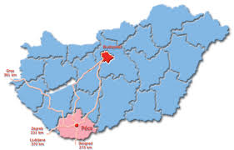
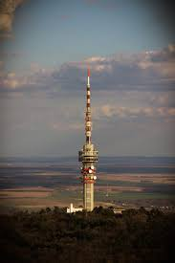
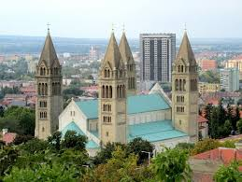
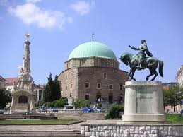

My city: Pécs
Population: 145.347 5th in Hungary
Located at the slopes of the Mecsek mountain sin the south-west of the country.
It was founded by the Romans in the 2nd century and it was a significant Christian center. The early Christian necropolis from this era is an UNESCO World Heritage Site. The first university in Hungary was founded here. It has a rich heritage from the 150 years Ottoman occupatin.

Slide 6
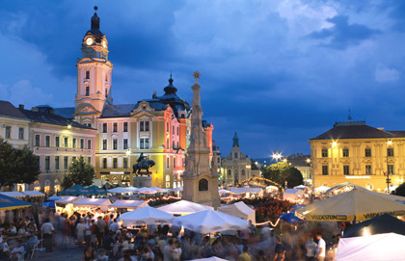
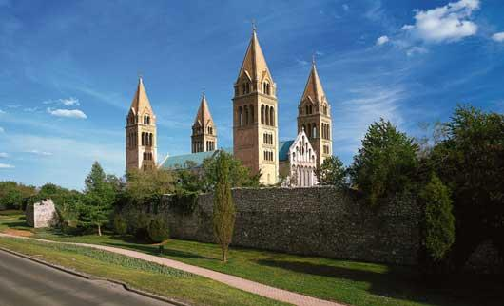
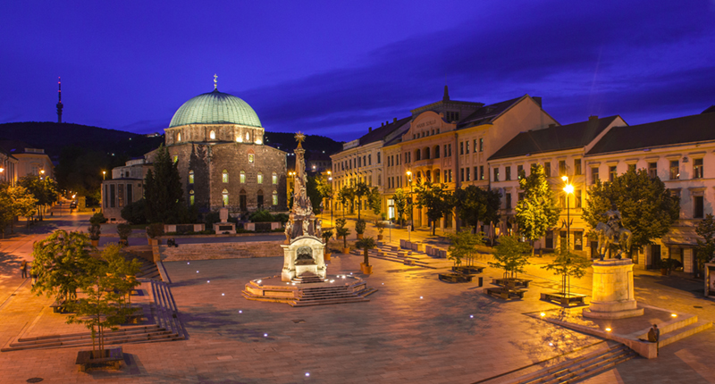
City Hall
Cathedral
Main square with Turkish mosque
(now a Catholic church):

Slide 7

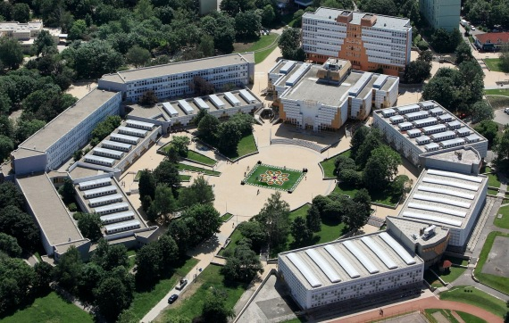
Our school
The Apáczai Educational and General Cultural Centre was opened in 1979. It’s made up of two primary schools, one high school, one dormitory, a sport’s centre and a cultural centre with a library and a theatre hall.

Slide 8
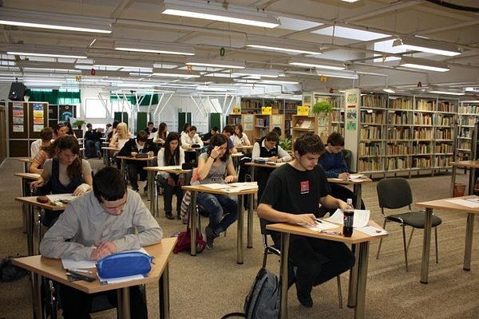
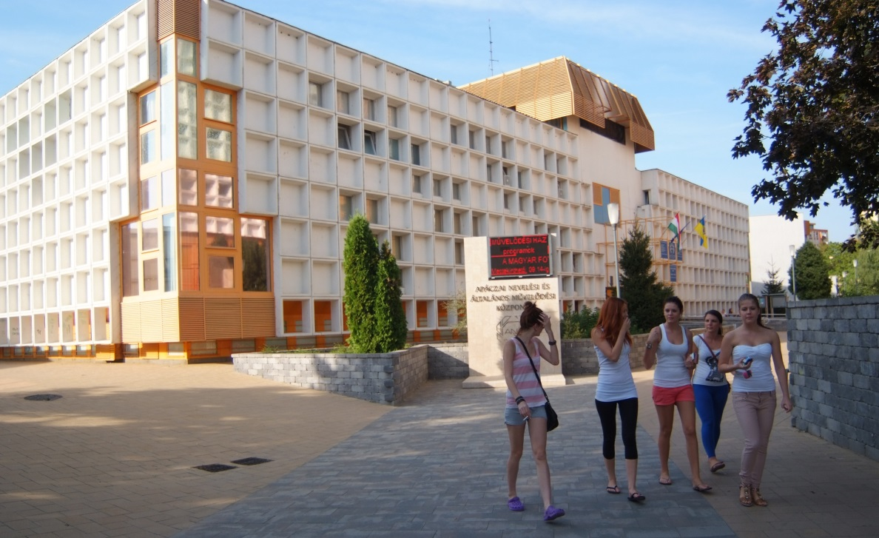
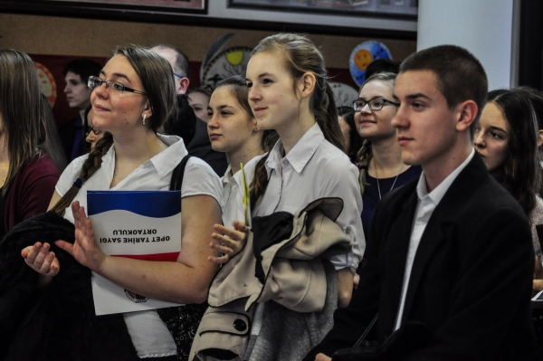
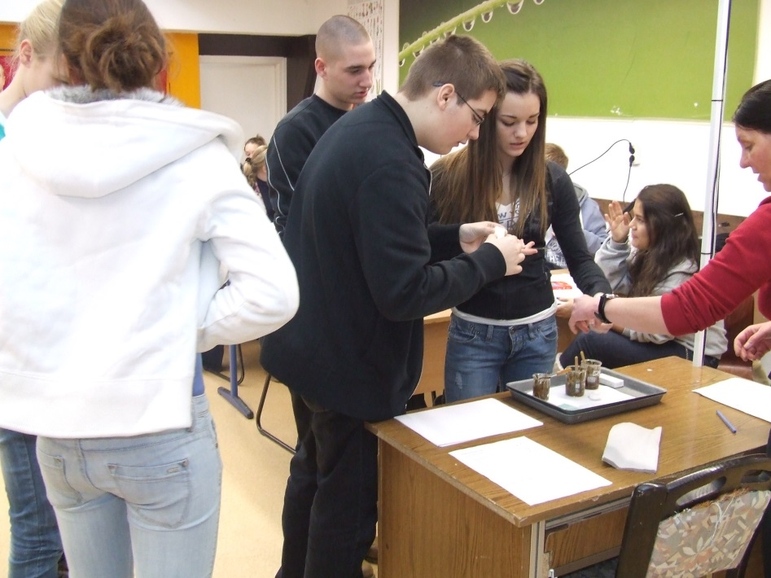
School life

Slide 9
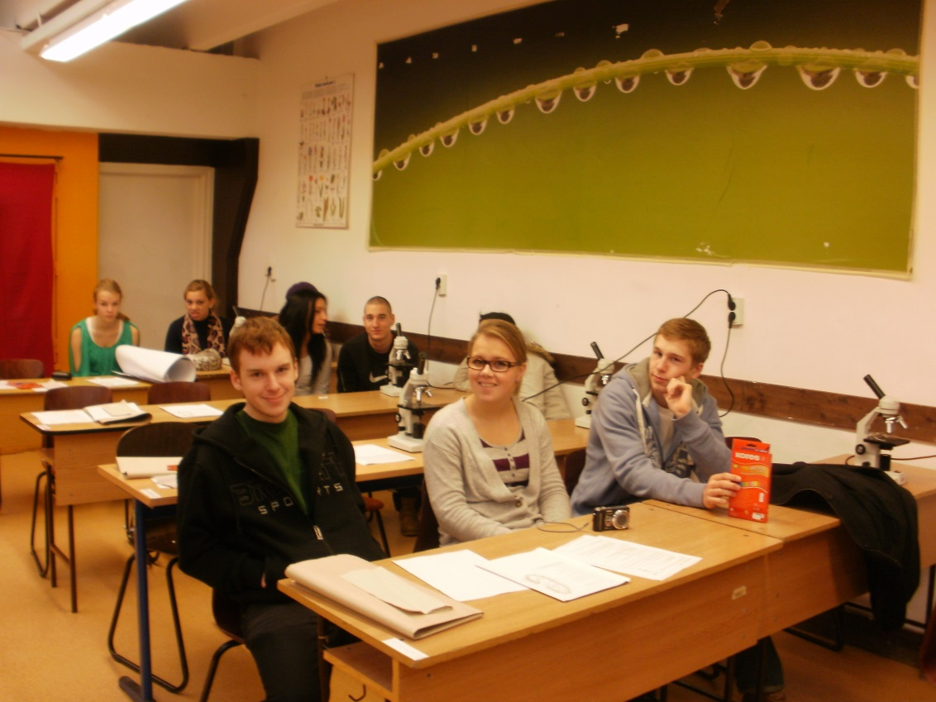
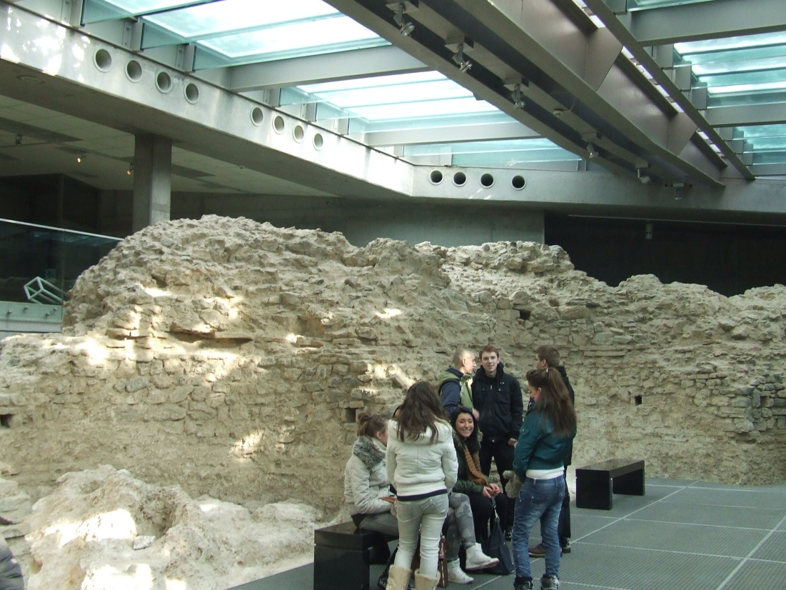
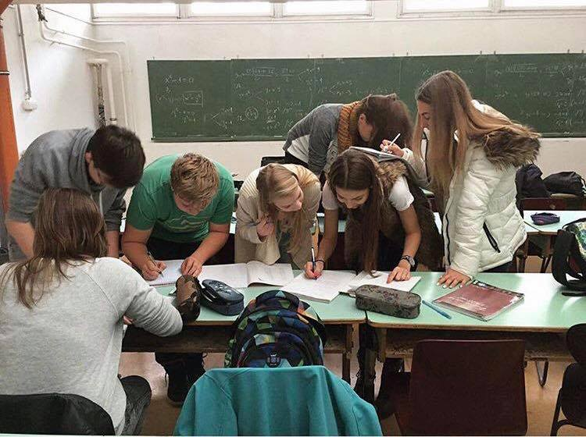

Slide 10
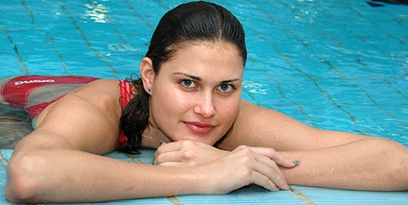
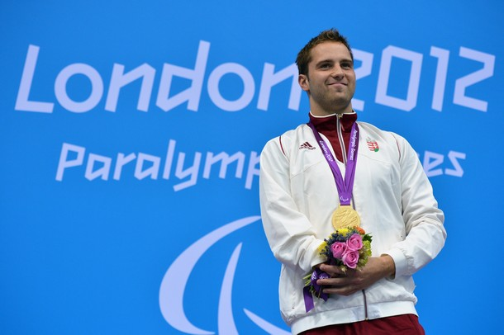
Famous ANK students
Zsuzsa Jakabos, finalist in 200 m butterfly
Chosen for the most beautiful participant
of the London Olympic Games.
She attended our school in Pécs!
Tamás Sors – another student of our school
Paralympic swimmer champion in Beijing
and London; silver medalist in Rio.

